Slide 1
Problem Statement
Efficient Traffic Analysis & Monitoring
Estimating the traffic density flow from the surveillance camera data.
Distance estimating from camera focal lens based on view angle.
categorizing the vehicle from 3D properties and vehicle count.
Distance between vehicles in frame.
Estimate and calculate the speed of vehicle from frame wide comparison

Slide 2
Image Enhancement
Histogram Equalization
Image has 256 pixel brightness values so there are 256 bins and the number of pixels are depicted using histogram
Histogram equalization is a technique for adjusting image intensities to enhance contrast
Adaptive histogram equalization
Adaptive histogram equalization (AHE) is a technique used to improve contrast in images.
It differs from ordinary histogram equalization in the respect that the adaptive method computes several histograms, each corresponding to a distinct section of the image, and uses them to redistribute the lightness values of the image.
It helps in improving the local contrast and enhancing the edges in each region of an image.
CLAHE
AHE overamplifies noise in homogeneous regions of an image. A variant of AHE, Contrast Limited Adaptive Histogram Equalization (CLAHE) prevents this by limiting the amplification.

Slide 3
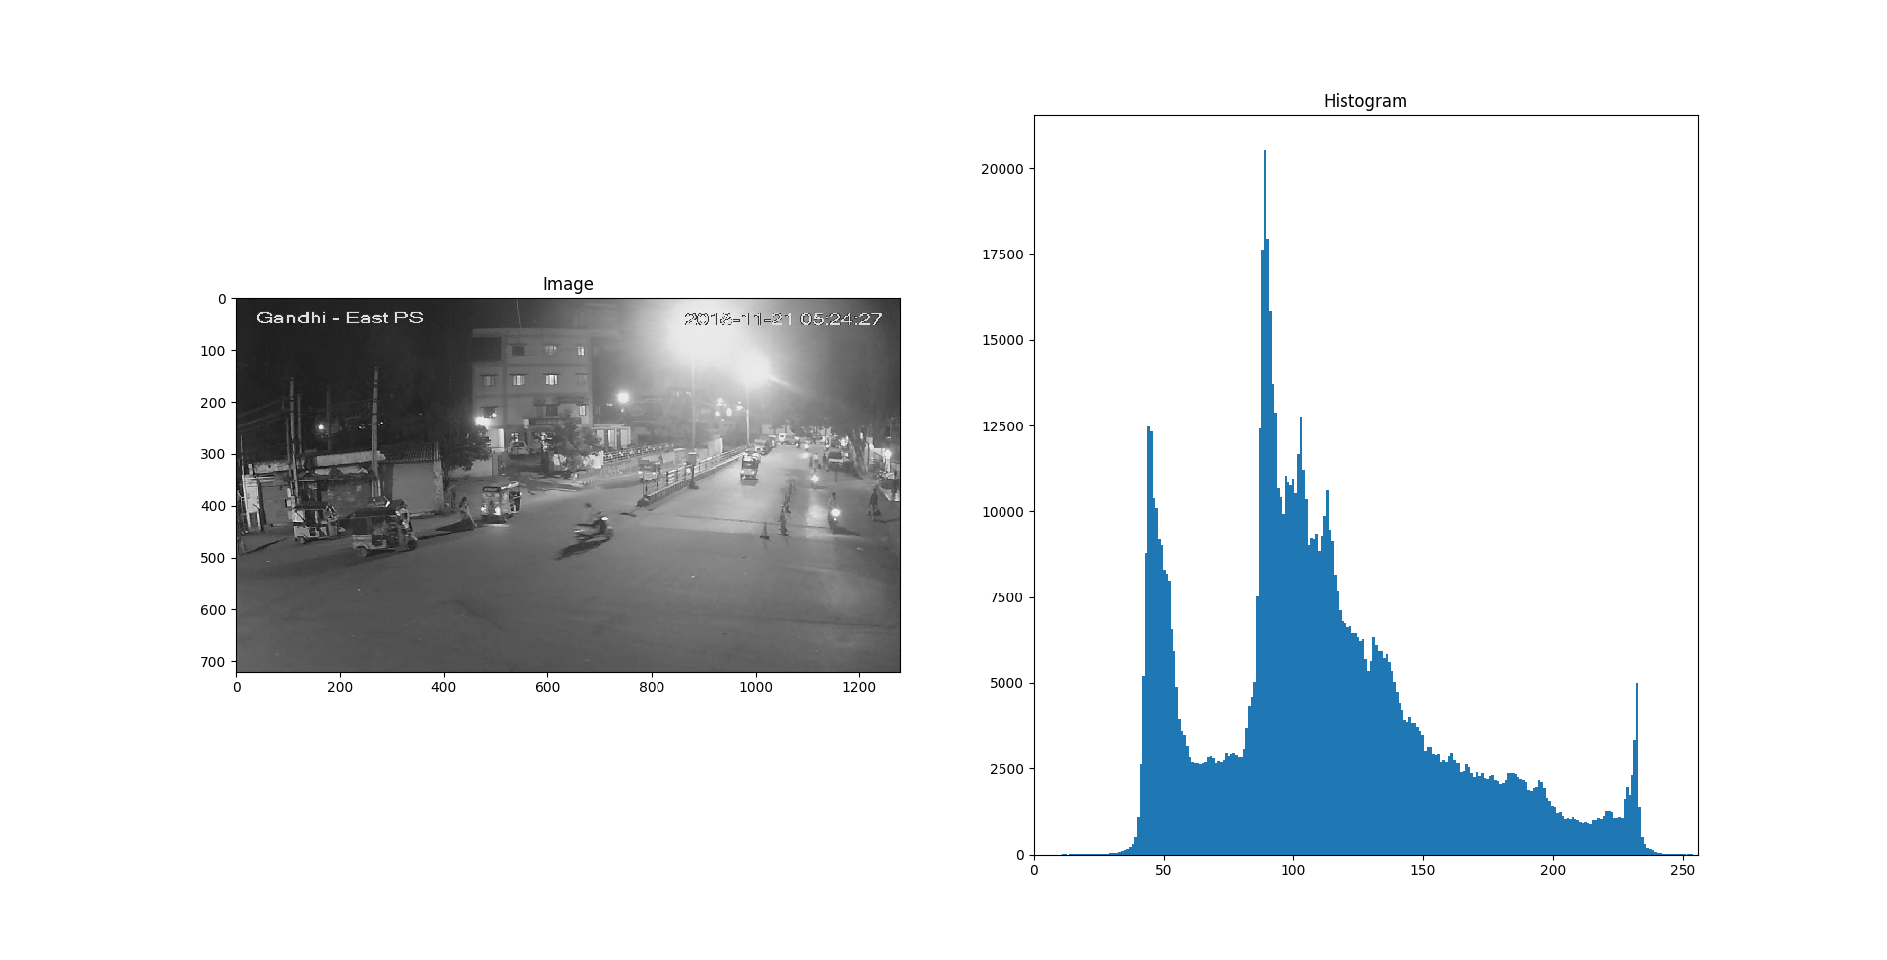
Figure 1: Histogram of the input image

Slide 4
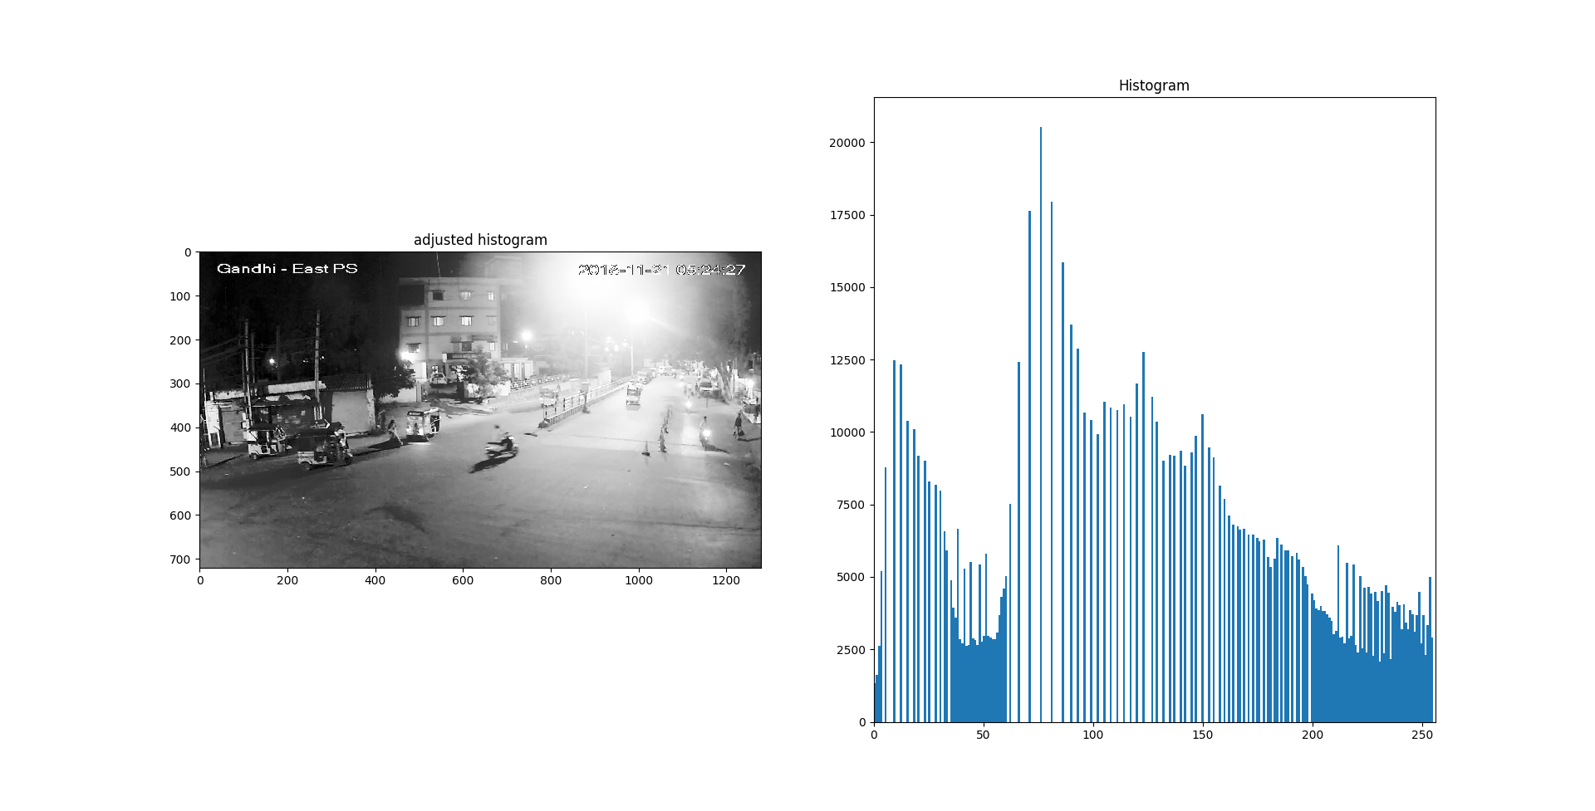
Figure 2: Adjusted histogram of the input image

Slide 5
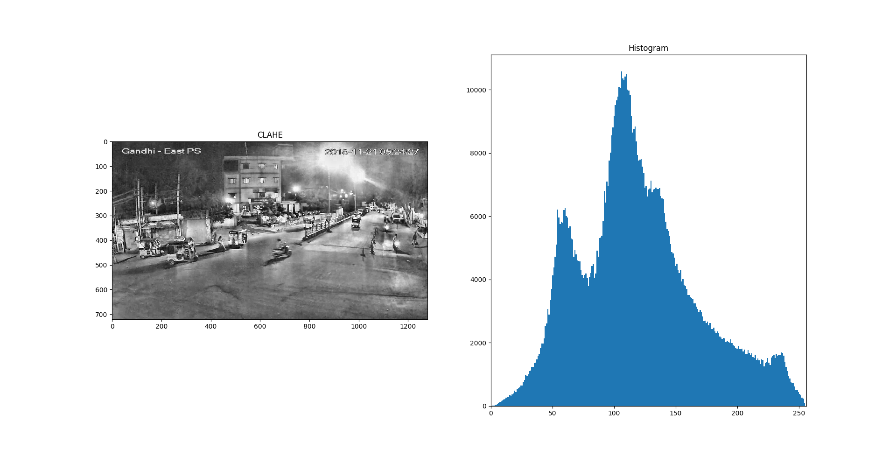
Figure 3: CLAHE applied to the input image

Slide 6
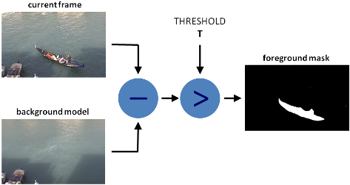
Background Subtraction
Background subtraction (BS) is a technique for generating a foreground mask.
A binary image containing moving objects in the scene.
Calculates the foreground mask performing a subtraction.
Figure 4: Background Subtraction

Slide 7

Morphological Operations
It is normally performed on binary images.
It needs two inputs, one is our original image, second one is called structuring element or kernel which decides the nature of operation.
Two basic morphological operators are Erosion and Dilation. Then its variant forms like Opening, Closing
Figure 5: Input image for Morphological Transformations

Slide 8



Dilation
Opening
Closing
It increases the white region in the image or size of foreground object increases.
A kernel slides over the image if the entire area in the kernel isn't black, then it is converted to white
It is useful in closing small holes inside the foreground objects, or small black points on the object.
We used this operation to decrease overlaping contours
It is primarly useful when we want to remove the noise in our image
We used this operation to reduce noise
Figure 6: Distilation
Figure 7: Distilation
Figure 8: Distilation

Slide 9
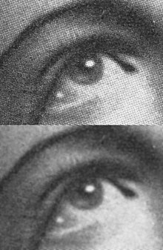
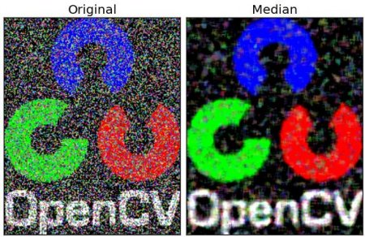
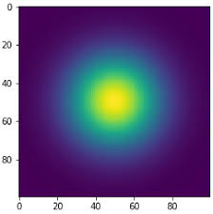
Gaussian Blur
Median Blur
Gaussian blur blurs an image by applying Gaussian function .It is used to reduce image noise and reduce detail.
The visual effect of this blurring technique is a smooth blur resembling that of viewing the image through a translucent screen.
Median blur takes median of all the pixels under kernel area and central element is replaced with this median value.
The visual effect of this blurring technique is removal of salt and pepper noise.
Figure 9: Gaussian Blur
Figure 10: Median Blur

Slide 10
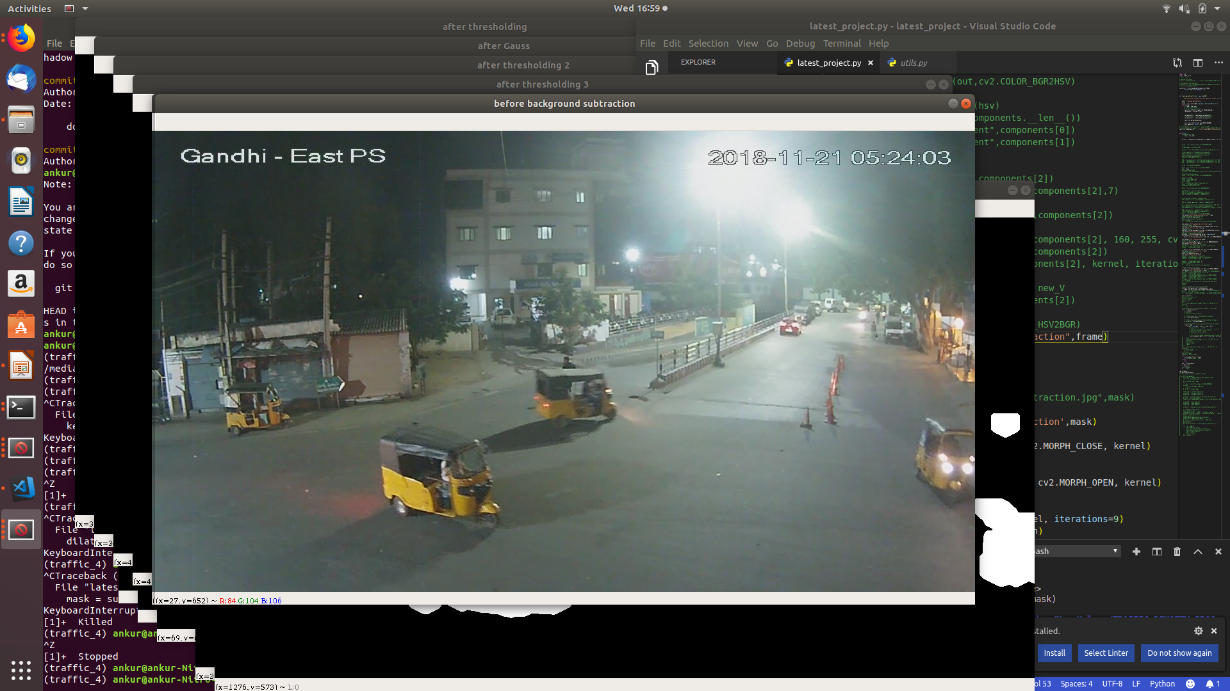
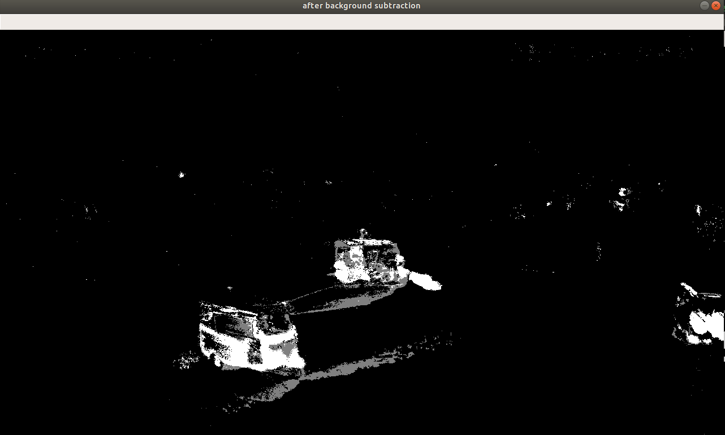
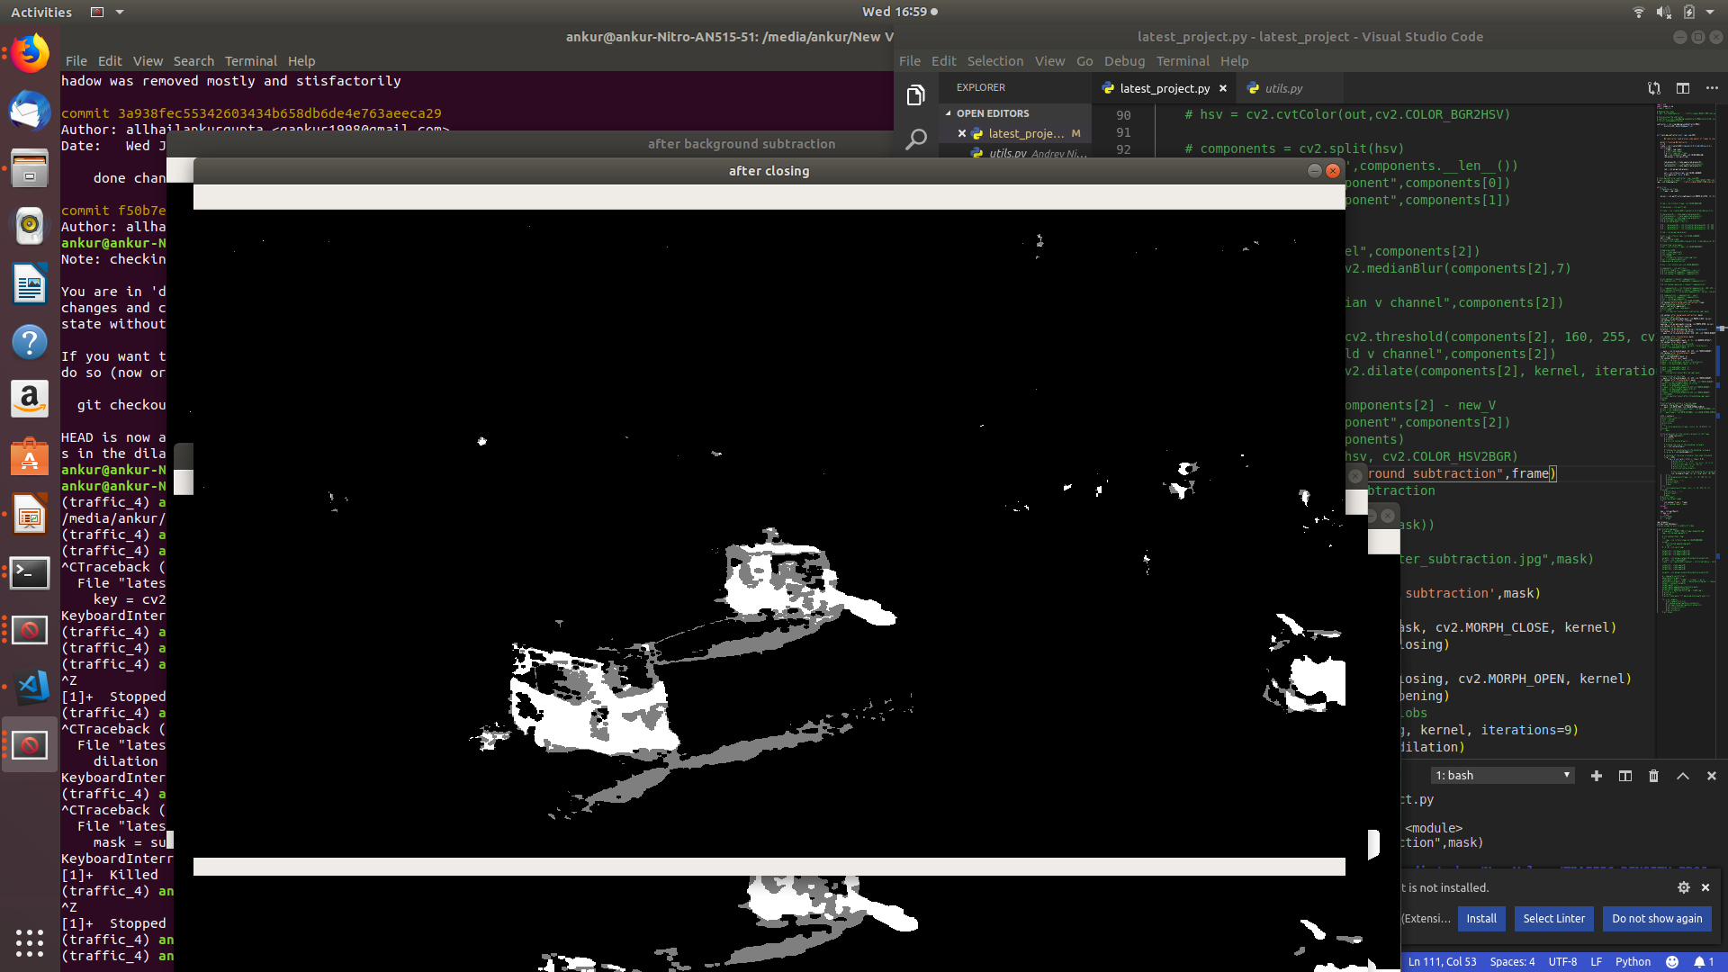
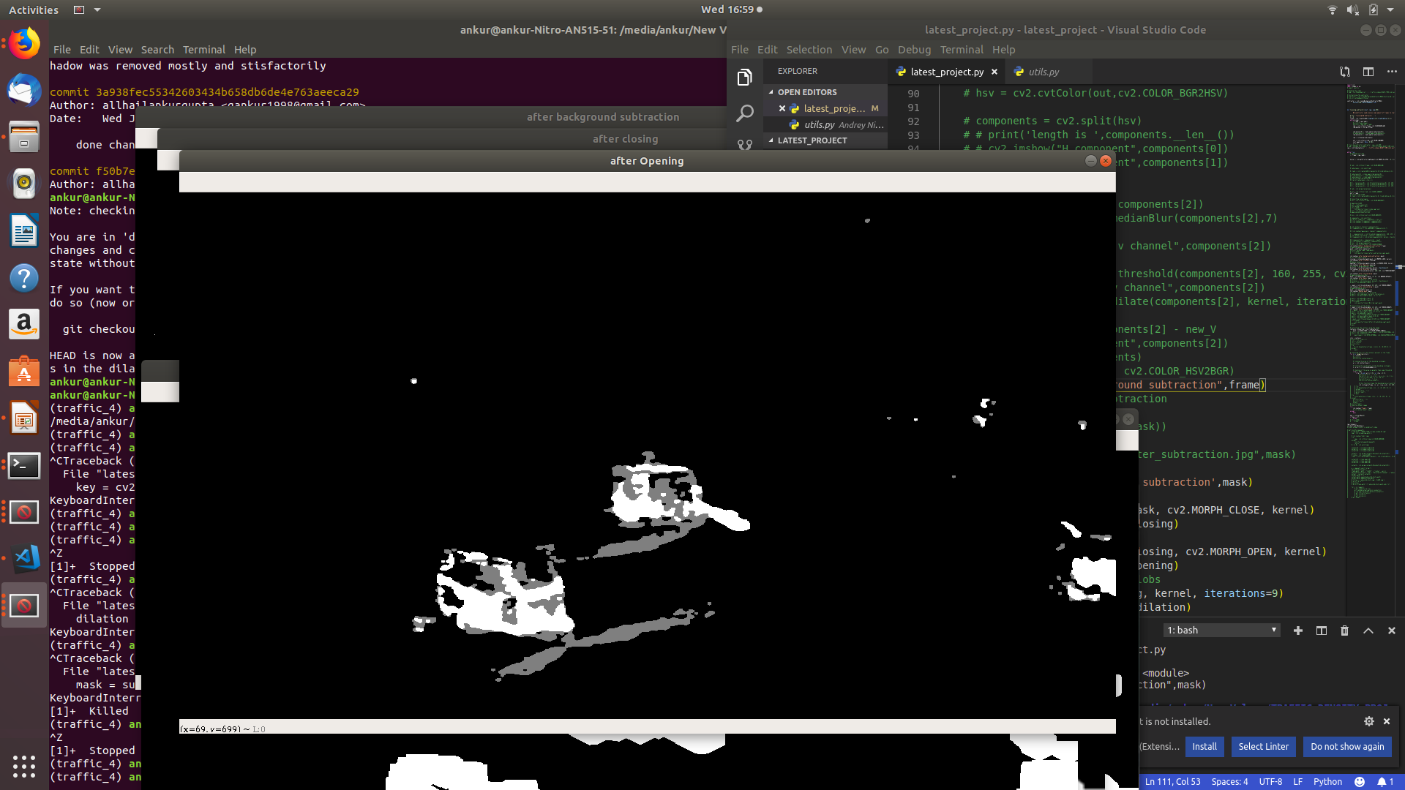
Original Frame
Frame After Background Subtraction
Frame after applying Closing Operation
Frame after applying Opening Operation

Slide 11
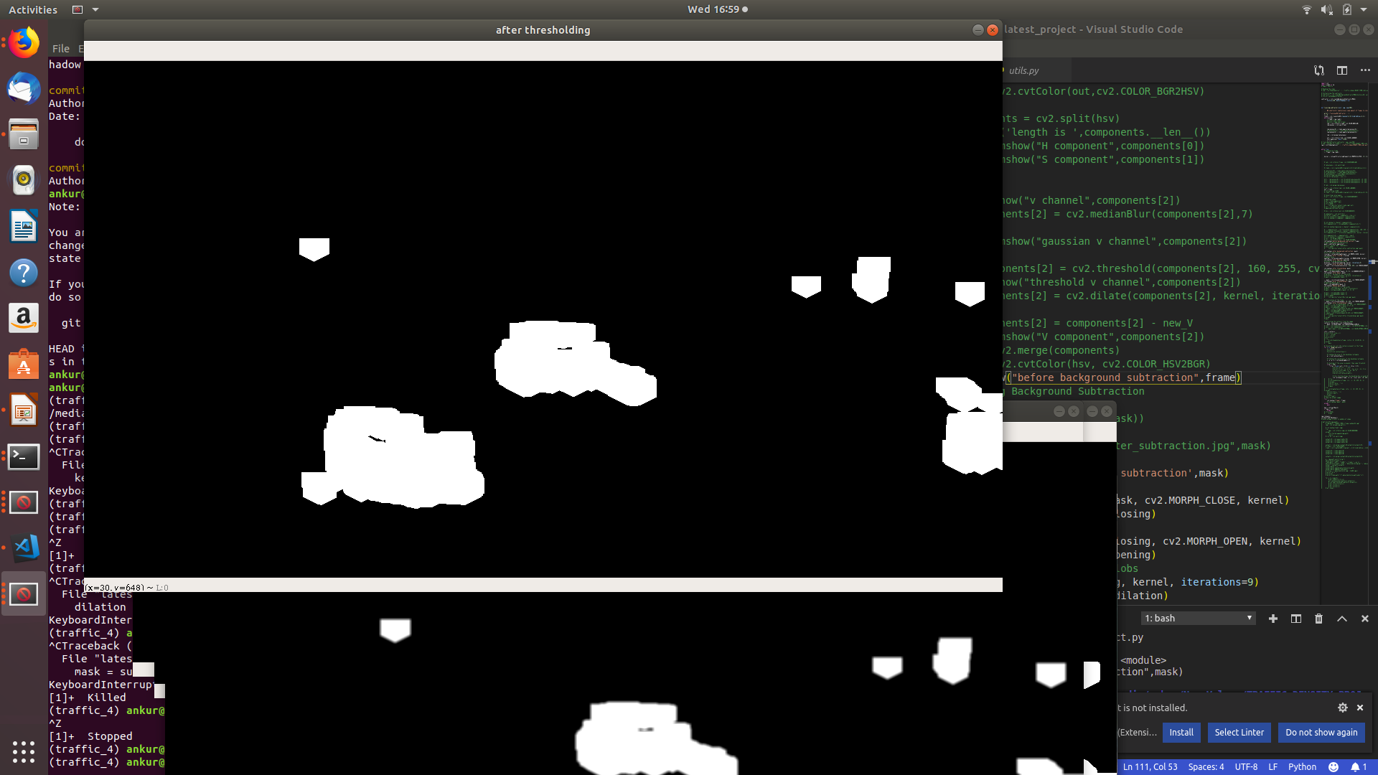
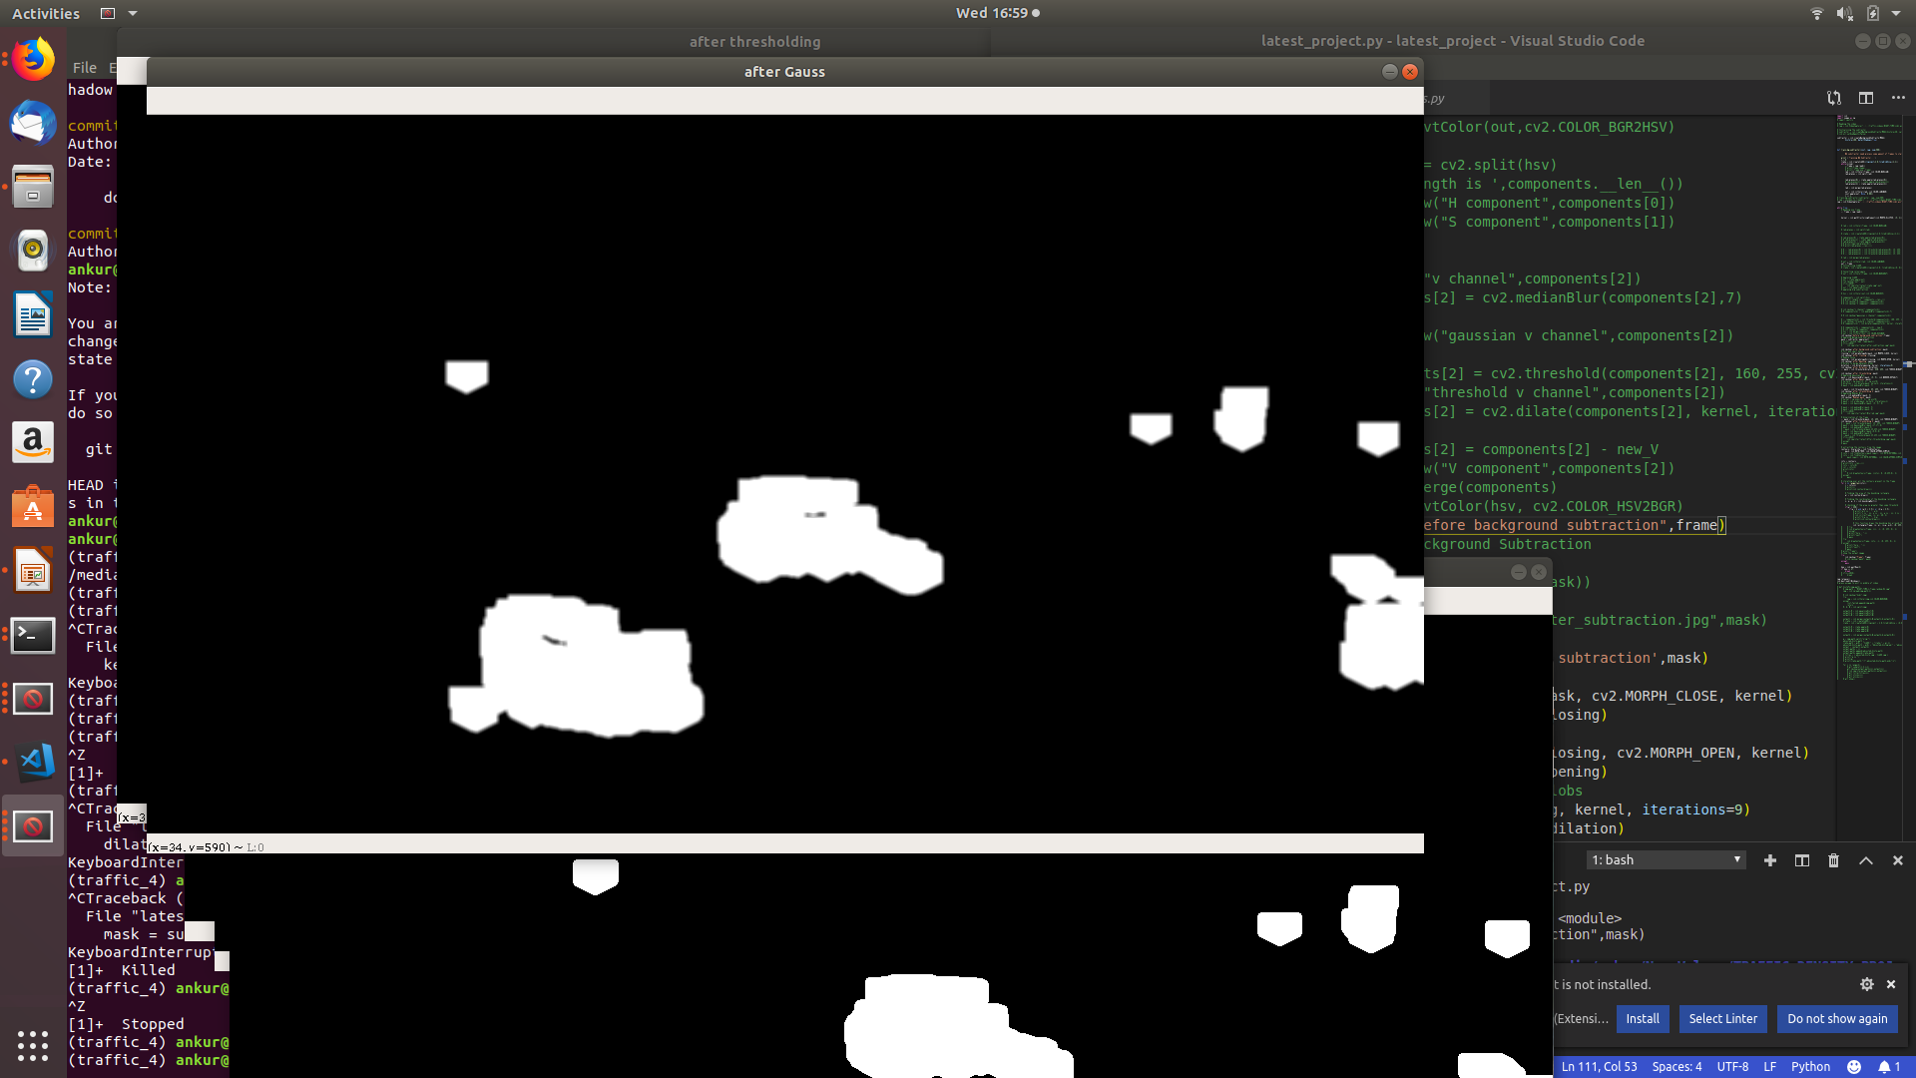
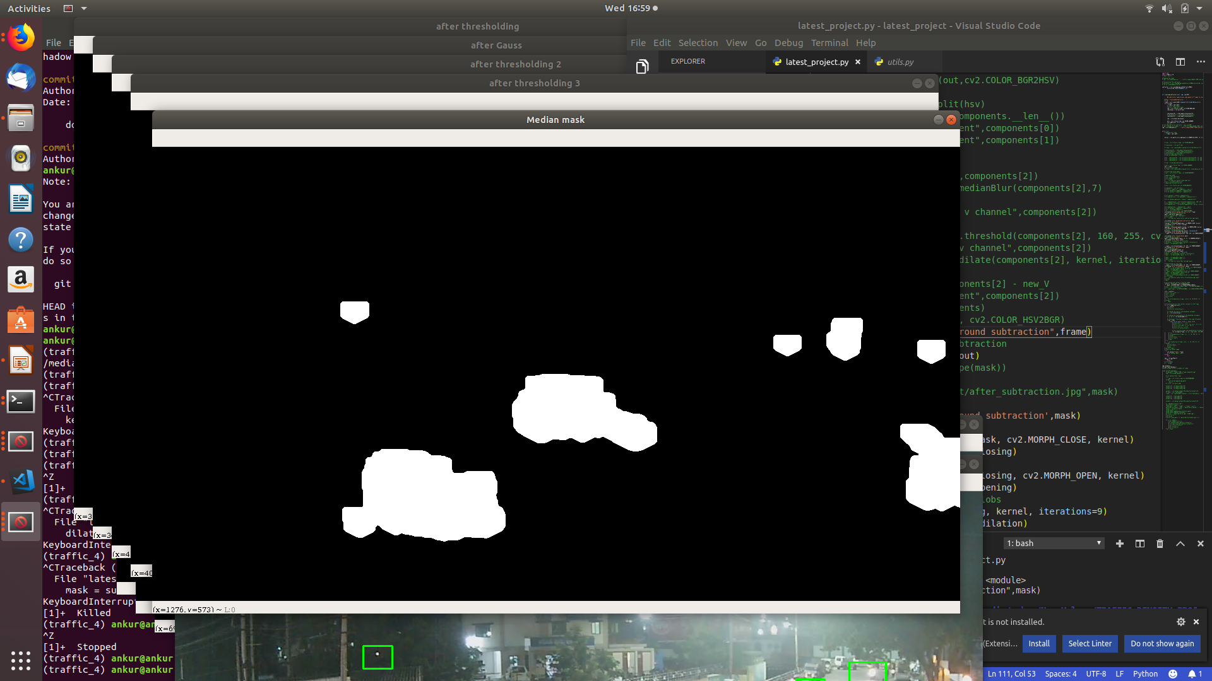
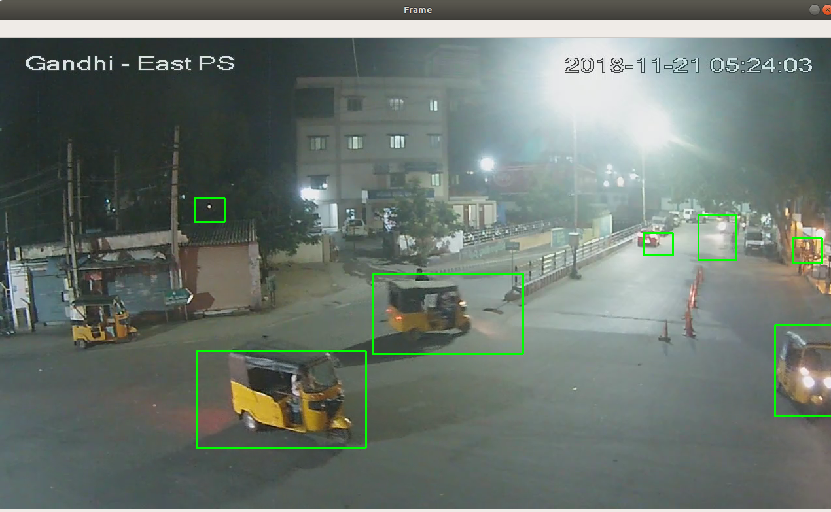
Frame after applying Dilation Operation
Frame after applying Gaussian Blur
Frame after applying Median Blur
Final Frame

Slide 12
Final Contour Detection
Original Frame
Final Frame
Figure 11: Contour detection for the input image

Slide 13
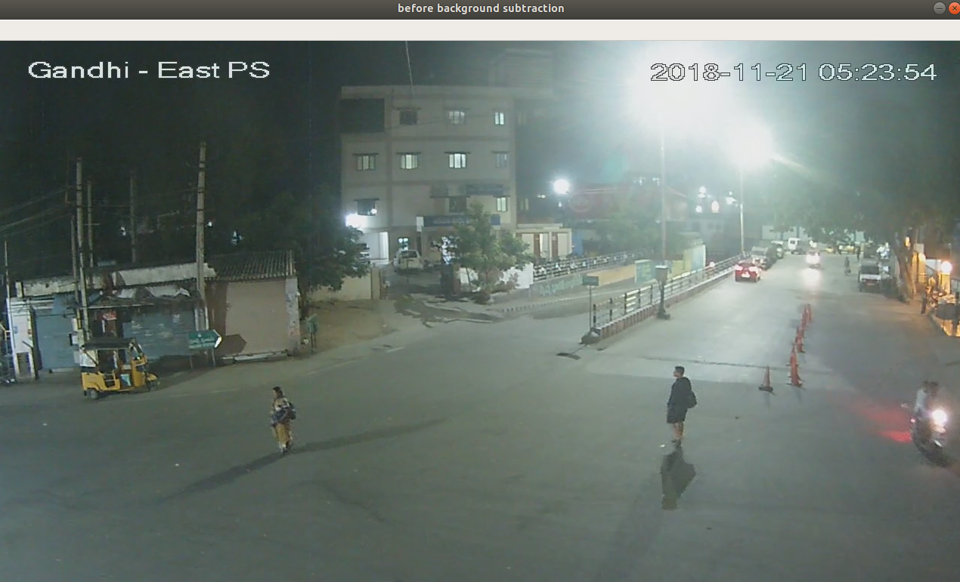
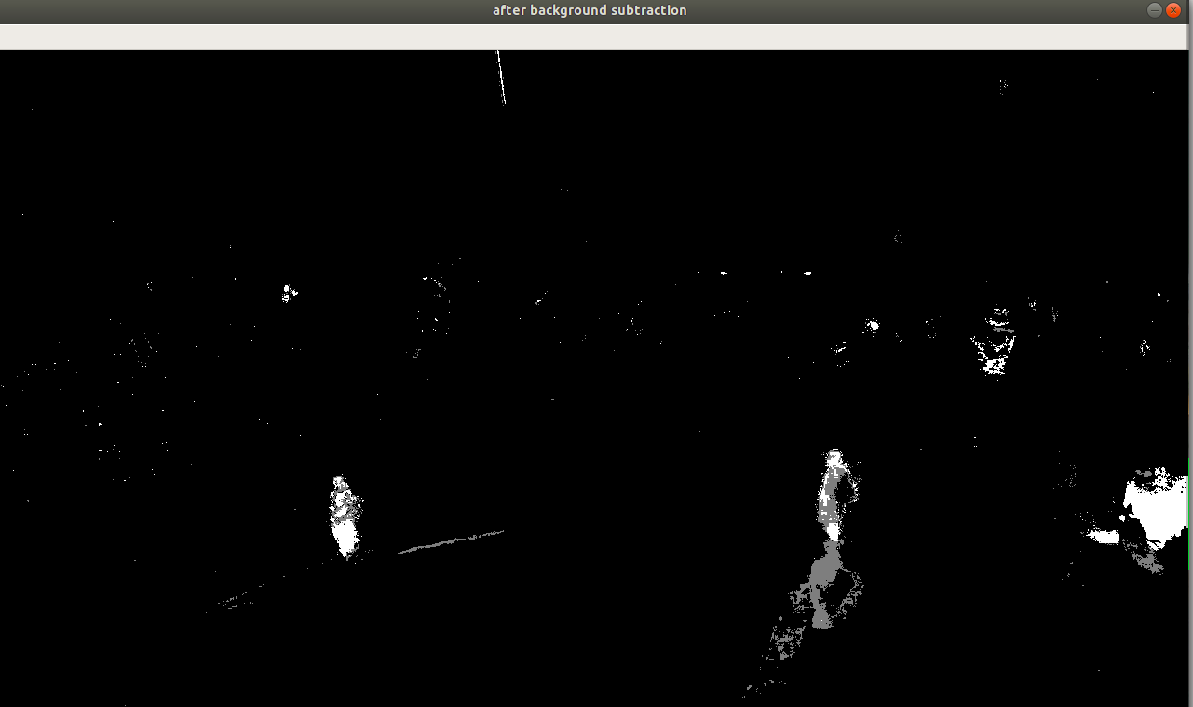
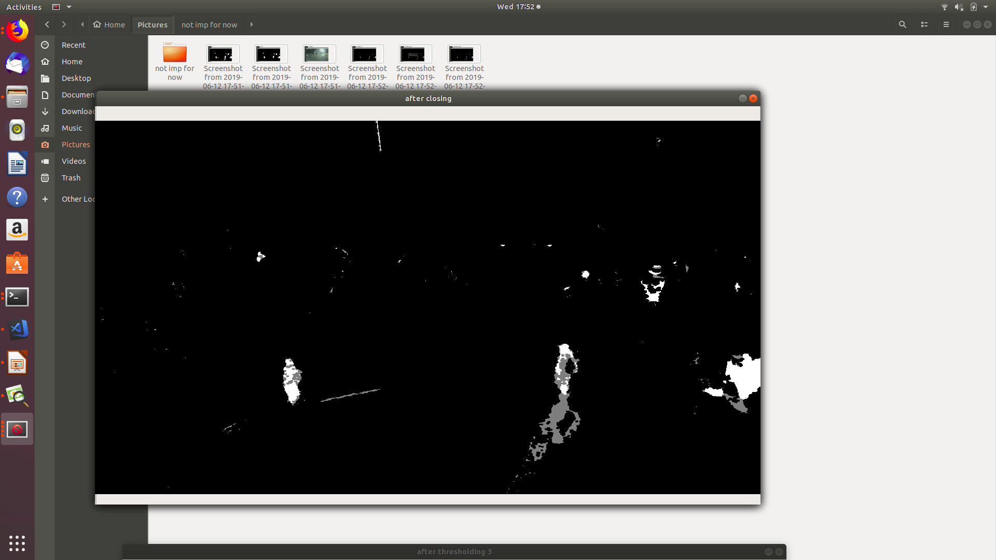

Original Frame
Frame After Background Subtraction
Frame after applying Closing Operation
Frame after applying Opening Operation

Slide 14
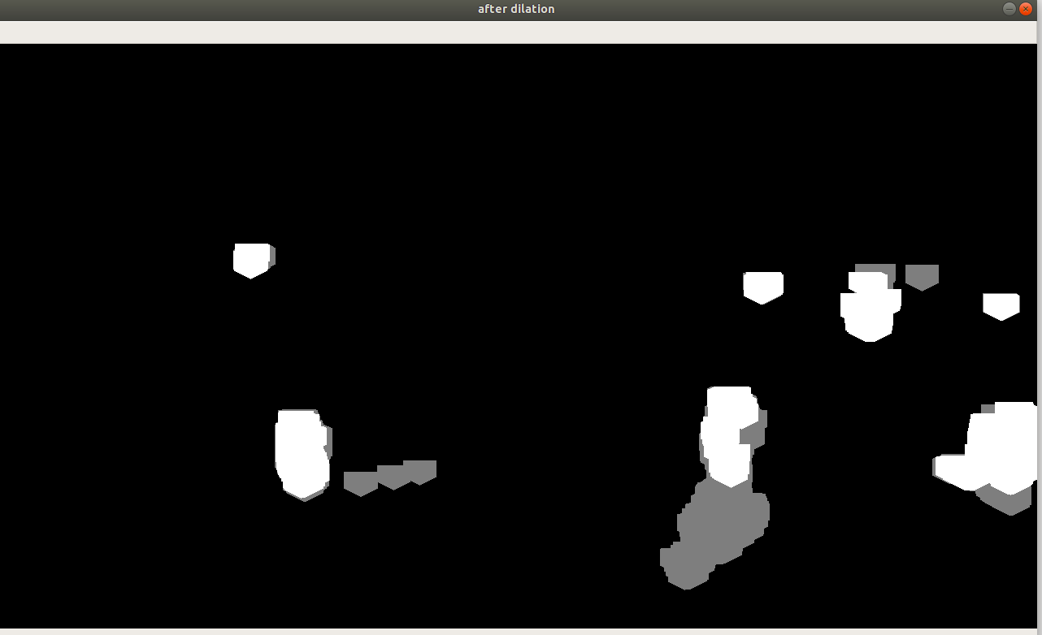
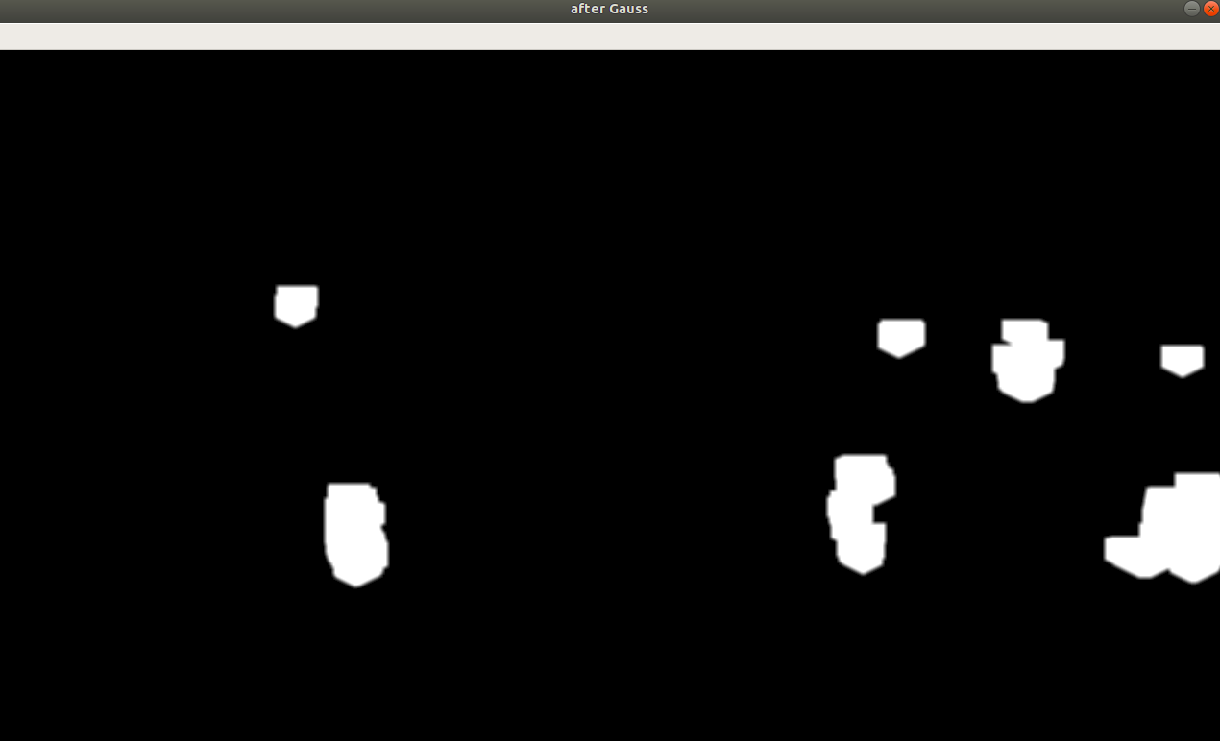
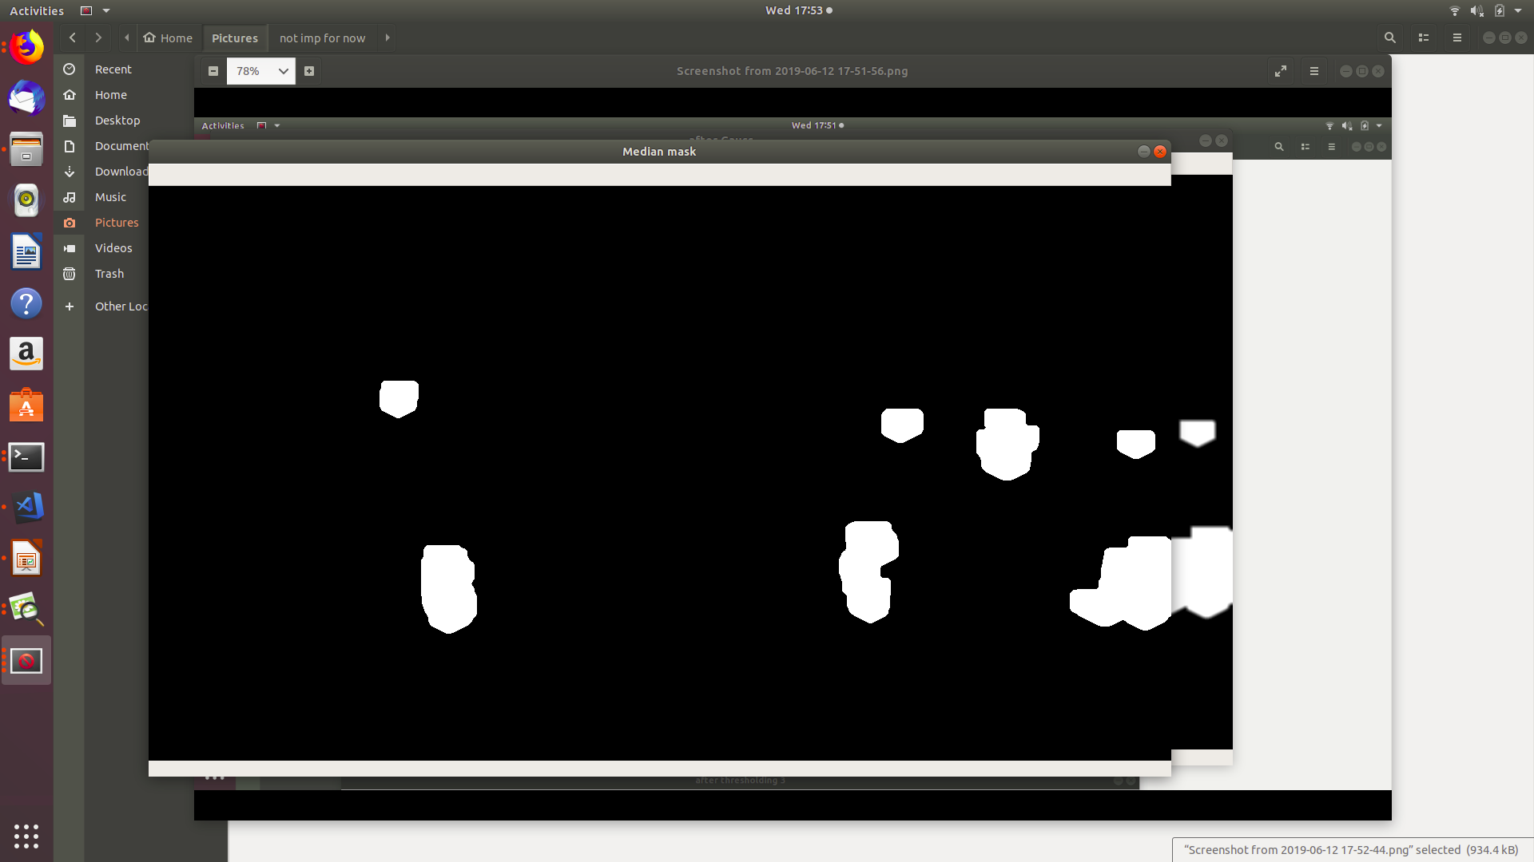
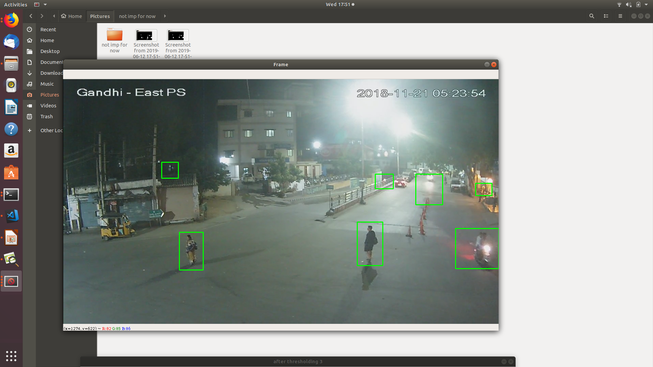
Frame after applying Dilation Operation
Frame after applying Gaussian Blur
Frame after applying Median Blur
Final Frame

Slide 15
Final Contour Detection
Original Frame
Final Frame
Original Frame
Final Frame
Figure 12: Contour detection for the input image

Slide 16
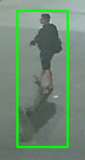
Notable Achievement
Removal of shadow
after a lot of experimentation
Figure 12: shadow removal

Slide 17
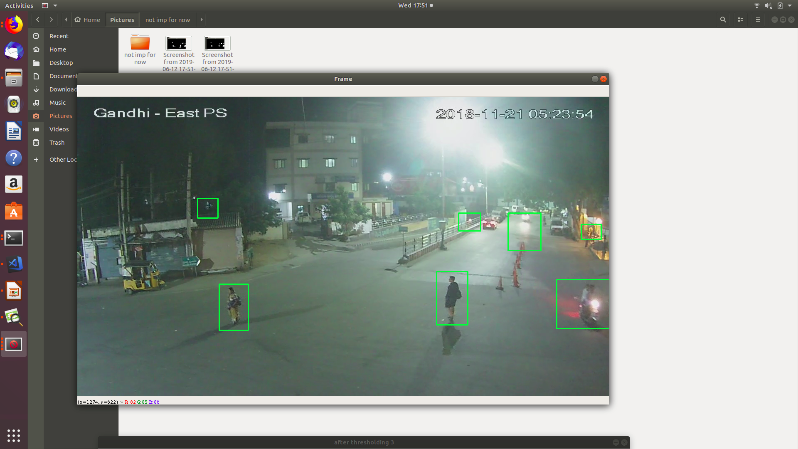
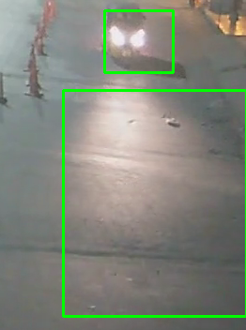
Notable Challenge
Removal of Illumination effect
It is making the area where the
light falls bright making it difficult
to distinguish between the object
and the light
Figure 13: Contours with light source

Slide 18
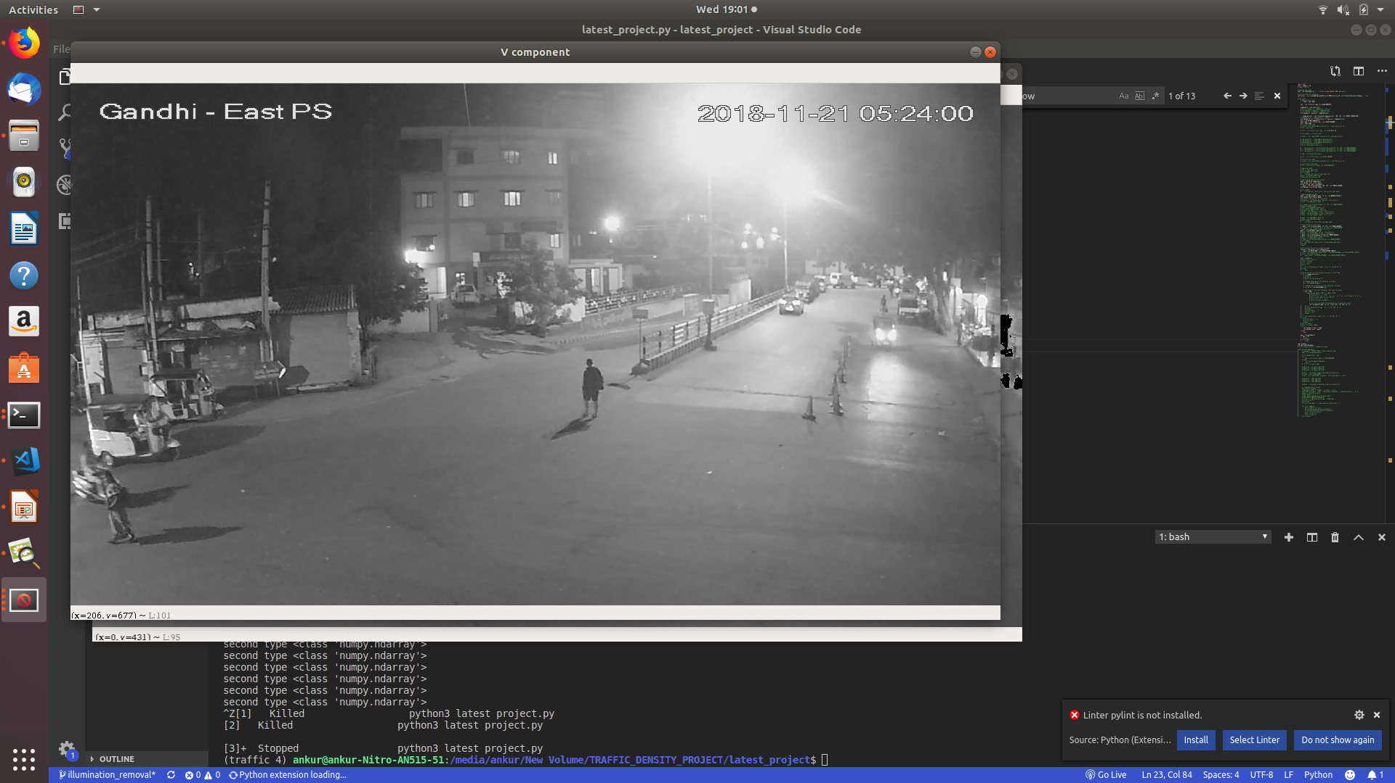
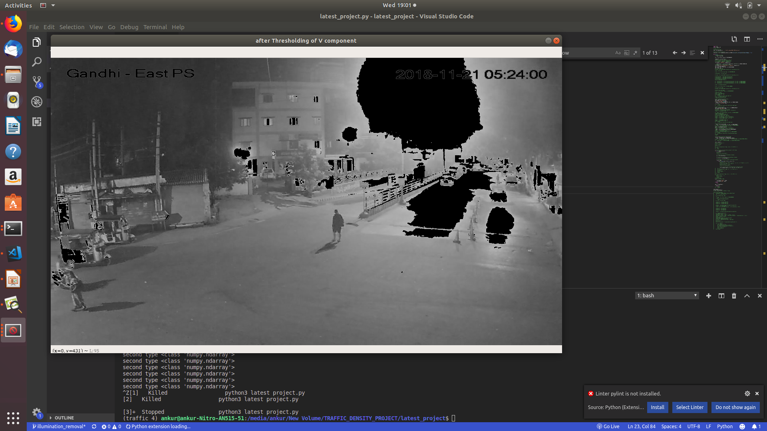
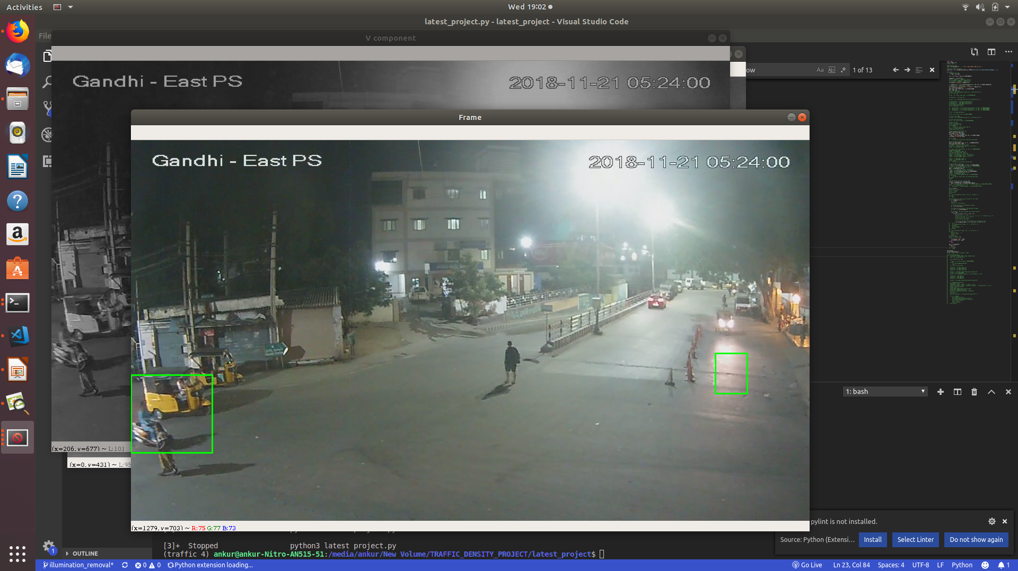
Efforts to overcome the challenge
Convert the image to HSV colour space
Split the channels and remove the
illumination effect from V component
Merge the channels
The output worked considerably but
affected other contours
V Component
Removing pixels with high brightness
Output
Figure 14: Removing High brightness parts from V component

Slide 19
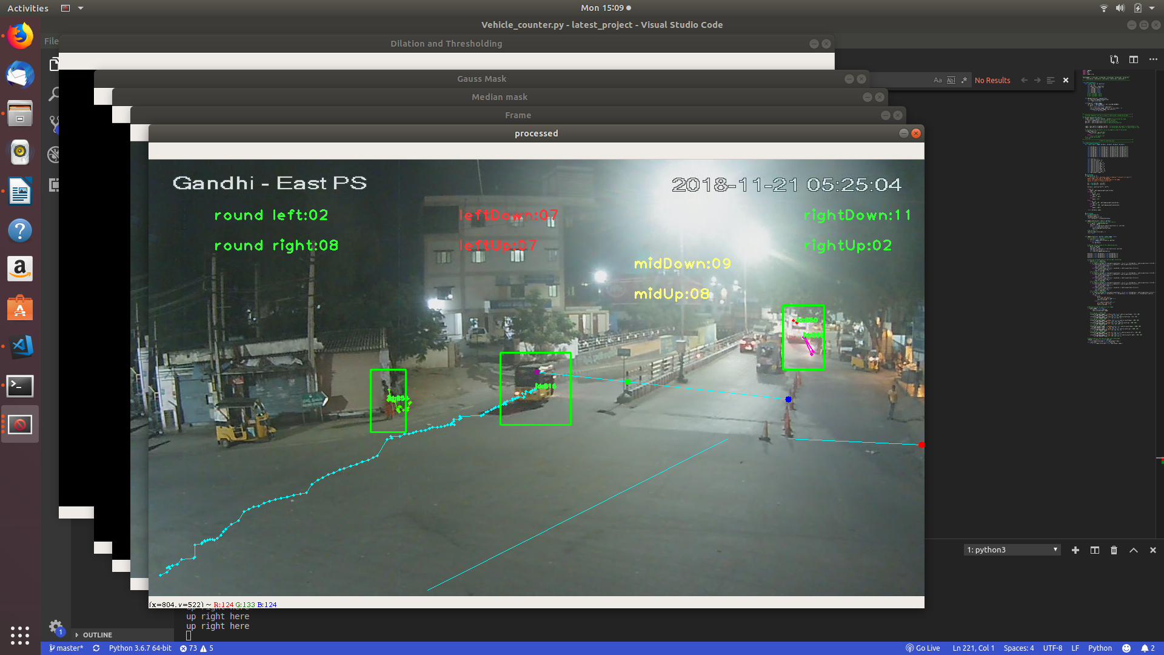
Tracking
Every Vehicle is assigned an ID
Position of the Vehicle is updated after every frame
Centroid based Tracking
Nearest Centroid is the next position
If vehicle not seen for more than 3 frames it is removed
To improve the overlapping contours Hierarchy was used
Figure 15: Trail of positions due to tracking

Slide 20
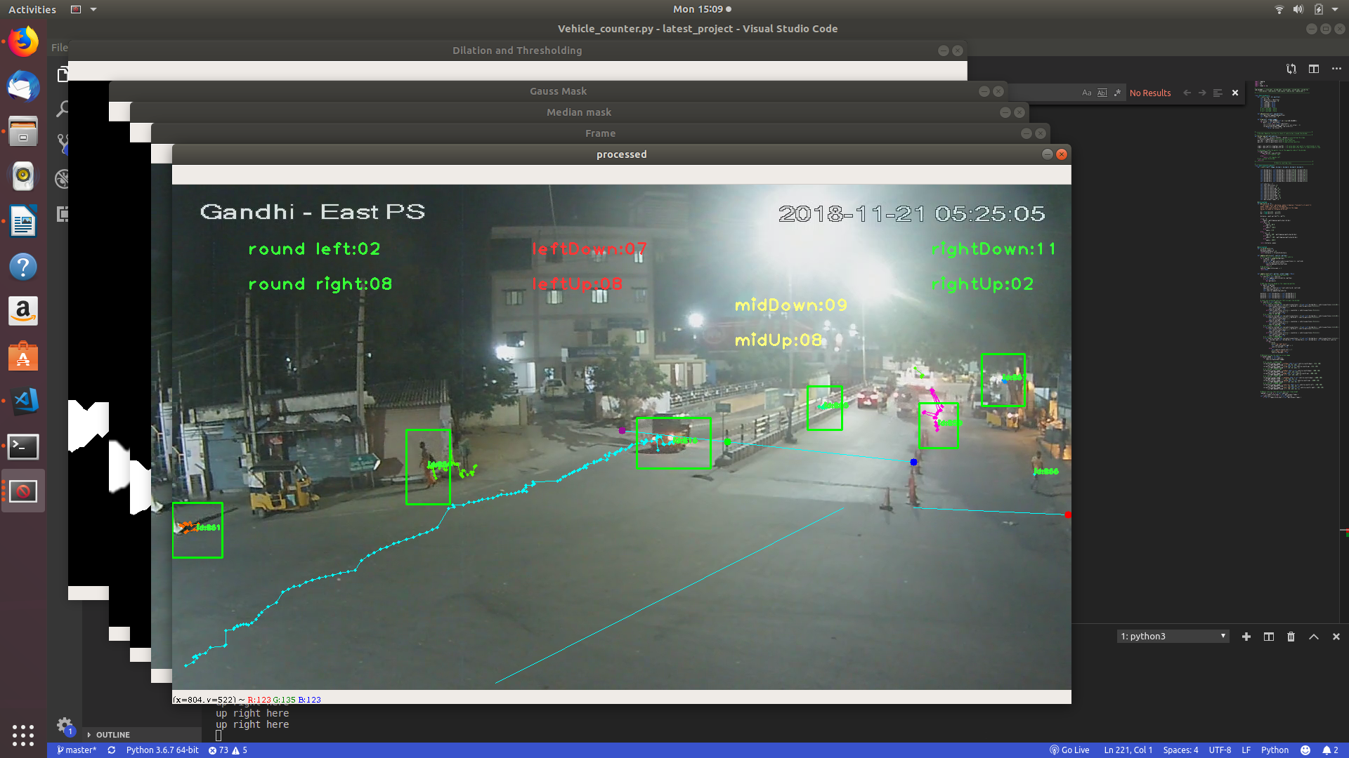
Counting
Dividers Placed at specific positions
Entity crossing the divider increases the count
Different count for incoming and outgoing Entities
Figure 16: Count increased when last position crpssed the border

Slide 21
Figure 17: Early morning, Counting and Tracking
Challenges
Merging of Nearby Contours
Contours due to Illumination

Slide 22
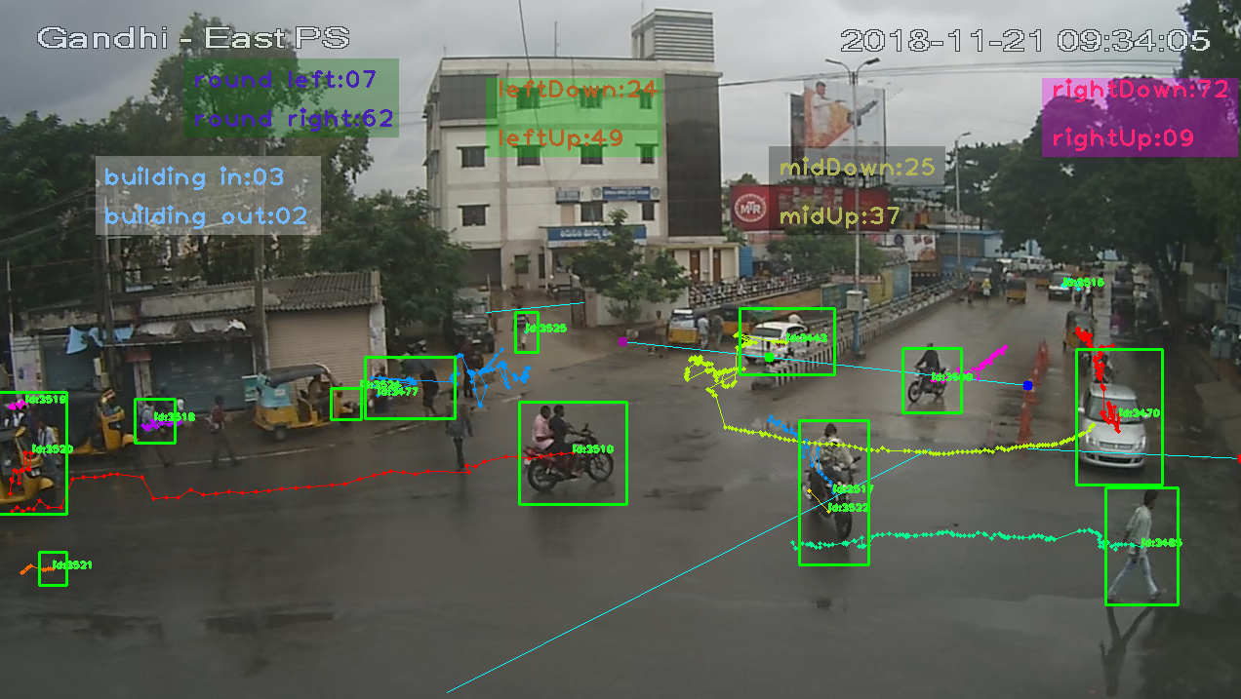
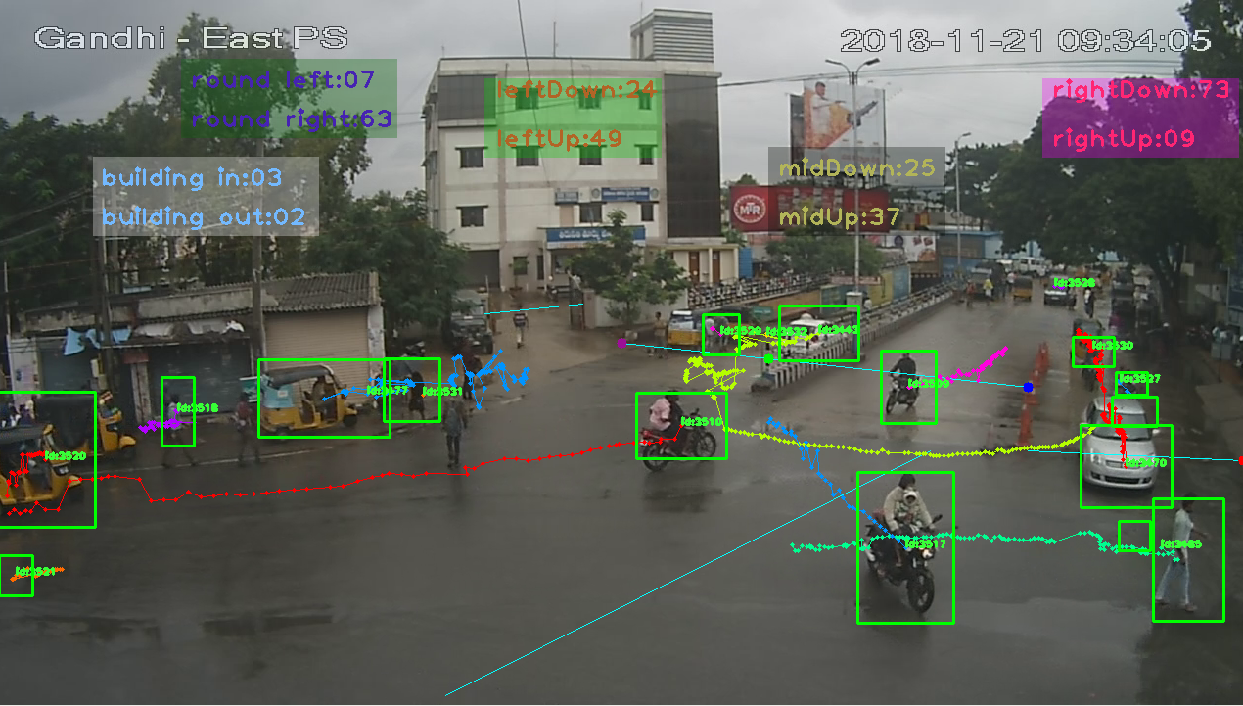
Figure 18: Morning, Counting and Tracking
Challenges
Change in road texture (rain) -> Reflection Detected as contour
Buses not having good contours
Drops on camera lens

Slide 23
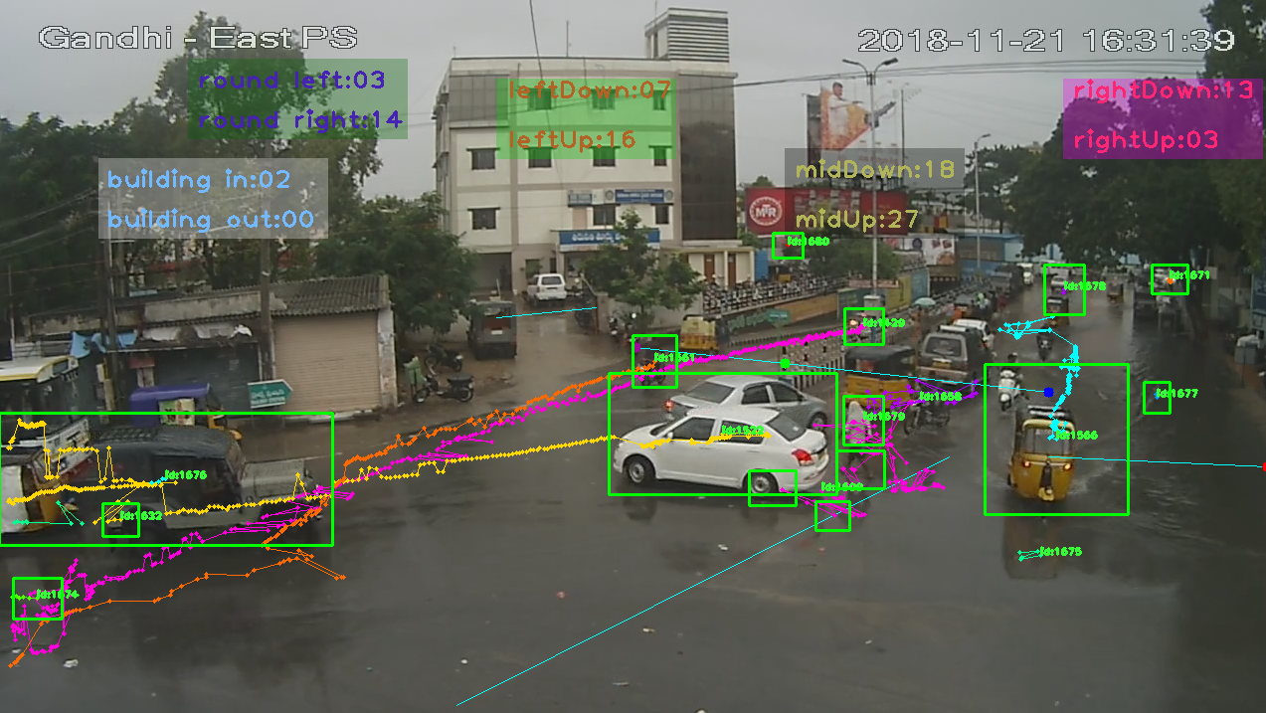
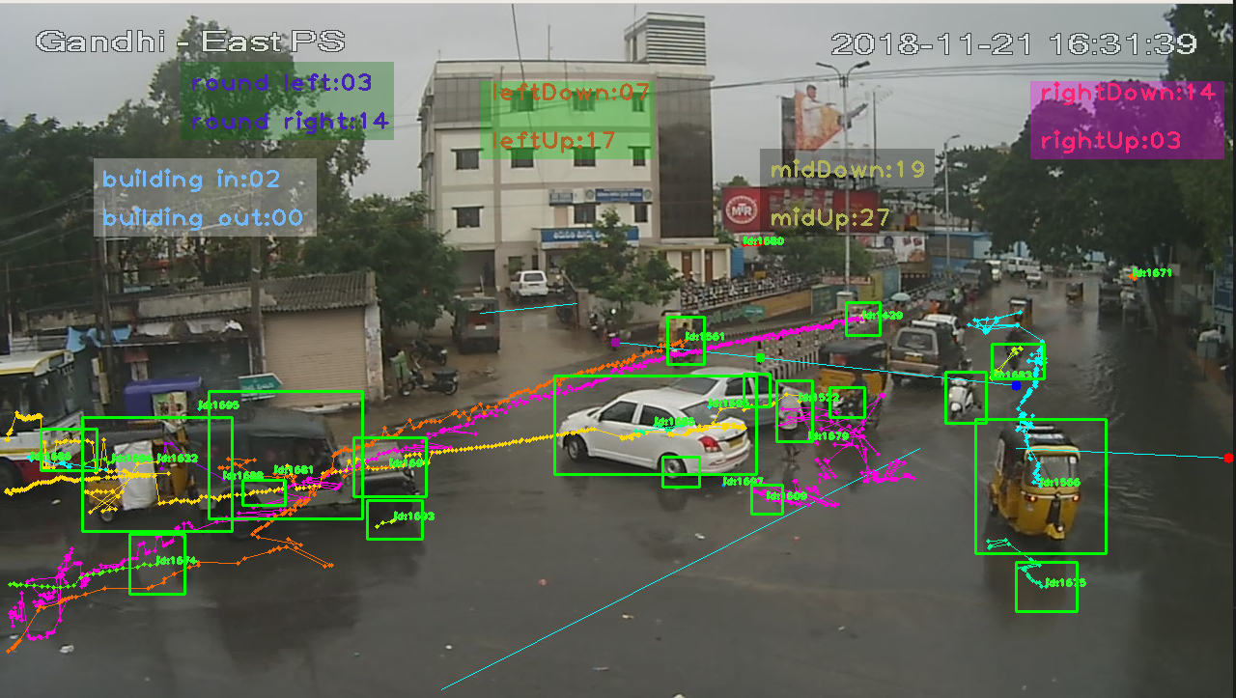
Figure 19: Evening, Counting and Tracking
Challenges
Change in road texture (rain) -> Reflection Detected as contour
Buses not having good contours
Moving water on road detected as contour
Problems due to illumination
Multiple contours due to occlusion

Slide 24
Challenges And Observations
S. No. | Category | Challenges | Changes Made and Observations
1 | Day Time (09:30 AM to 11:30 AM) | Merging of nearby contours | Reduced Dilation and changed Kernel size (improved results)
 |  | Overlapping Contours | Used Hierarchy (improved results)
2 | Early Morning (5:30 AM to 7:00 AM) | Illumination making false contours | Trade of between reducing illumination and effect on nearby contours
 |  | Merging of nearby contours
3 | Evening to Night (16:30 to 18:30) | Moving water detected as contours
 |  | Heavy illumination due to rain water reflection

Slide 25
Time Line
Phase 1
Phase 2
Completed till Here
Started with Phase 3
Phase 3
Phase 4
Annotation
Deploying application over cloud
Divide Video into Frames
Background Subtraction
Contour Detection
CNN
Mobile App Deployment
Night Vision Enhancement
Improvements
/revisions
Tracking of objects and counting
Detection and Distance computation

Slide 26
References
https://www.tutorialspoint.com/erosion-and-dilation-of-images-using-opencv-in-python
https://www.learnopencv.com/filling-holes-in-an-image-using-opencv-python-c/
https://dsp.stackexchange.com/questions/454/detecting-trail-in-forest-images/459#459
https://dsp.stackexchange.com/questions/2247/how-can-i-remove-shadows-from-an-image
https://docs.opencv.org/3.1.0/db/d5c/tutorial_py_bg_subtraction.html
https://docs.opencv.org/3.0-beta/doc/py_tutorials/py_imgproc/py_morphological_ops/py_morphological_ops.html
https://docs.opencv.org/3.4.0/d9/d8b/tutorial_py_contours_hierarchy.html

